Slide 1
AI Memory Contamination Detection System Analysis
Benjamin Landry

Slide 2
TOC
Overview
Understanding the problems
Project objective
Contamination Sources
ROC Curve

Slide 3
Overview
The code implemented a sophisticated system for detecting and mitigating memory contamination in AI models. This is crucial for ensuring AI systems don't inadvertently reveal sensitive or proprietary information they were previously exposed to.
I originally hypothesized that by analyzing generated code, from StackOverflow and Reddit, instances can be identified where the model outputs information that strongly suggests memorization of sensitive data rather than genuine code generation based on a given prompt.
I ended up strictly using StackOverflow for testing data as Reddit had a lengthy process to be approved for API usage.

Slide 4
Understanding the problems
01
Develop and evaluate a methodology for detecting and potentially mitigating AI memory contamination in code generation
02
Analyze code snippets and natural language descriptions sourced from Stack Overflow
03
Identify inadvertent revelations of sensitive or private information

Slide 5
Project objective
Investigate different methods to analyze structural characteristics of generated code. Utilize a BERT model to encode both generated code descriptions and segments of the training data from Stack Overflow.
Develop a technique to to analyze relations between user prompts and generated code snippets such if generated output contains sensitive information that is completely irrelevant to a user’s prompt, it hints at suspicion of memory contamination.

Slide 6
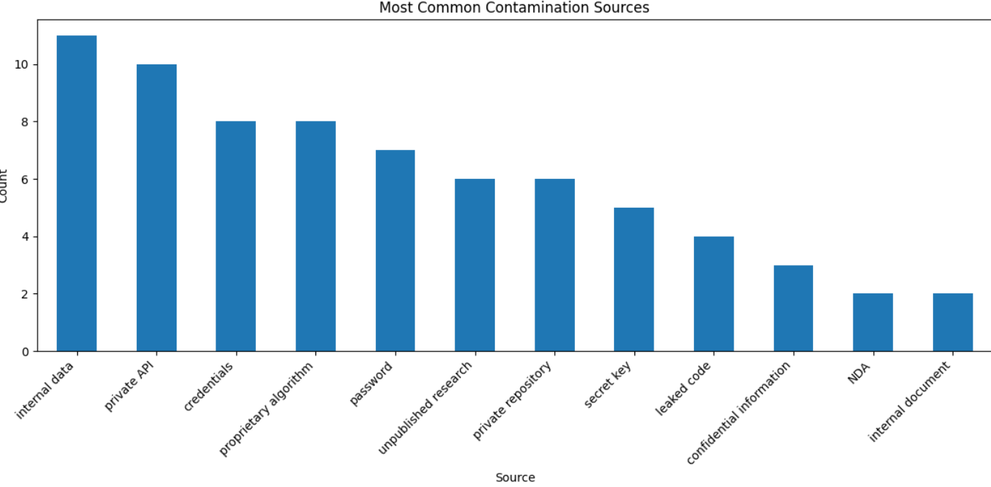
Most “Contaminated” Sources
The system built specifically looks for key indicators of potential contamination. In other words, I used a find_contamination_sources() function that explicitly searches for those patterns.
With enough time, I could have also explored using a BERT-based model that learns contamination patterns from the training data.
The system's effectiveness at identifying these contamination sources directly affects its ability to maintain proper information boundaries and prevent the AI from inadvertently sharing sensitive information it was previously exposed to.

Slide 7
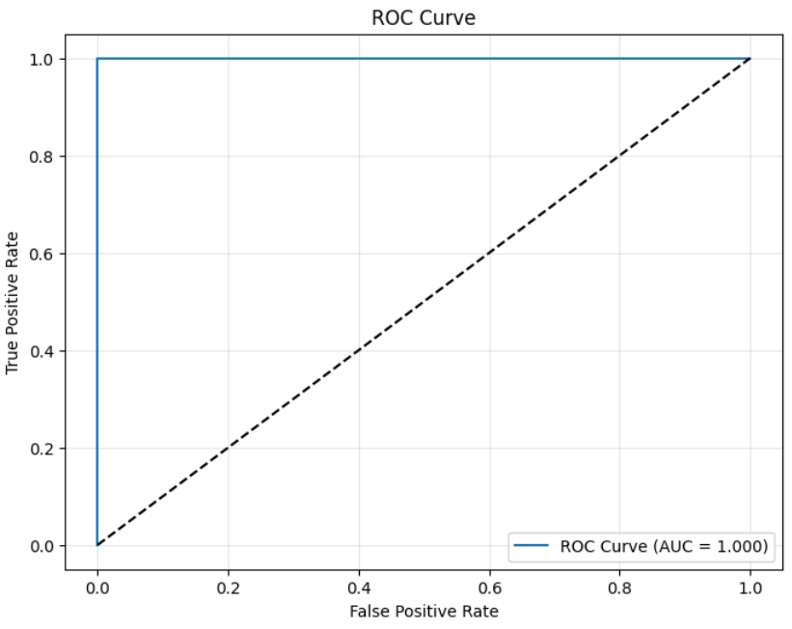
ROC Curve
This ROC curve is suspiciously perfect. I am sure given the result, the system overfitted the synthetic data.
Using the specific key identifiers, the classification task implemented was much too specific. Whereas real-world examples are most-likely much more subtle.
A more useful ROC curve should demonstrate some trade-offs between true and false-positive rates.

